Slide 1
A3.ba
Objects and Operations
Sabah Ul-Hasan
Credit: Huitian Dao

Slide 2
Zoom Poll
How are you feeling?
Good. I’m starting to get the hang of this.
Meh. Could be better, but I’m getting there.
Terrible. I’m constantly frustrated. The world is a mess, but at least there’s bioinformatics.
Notes:
Want to know if you encounter unwelcoming behavior outside or inside classroom

Slide 3
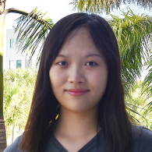

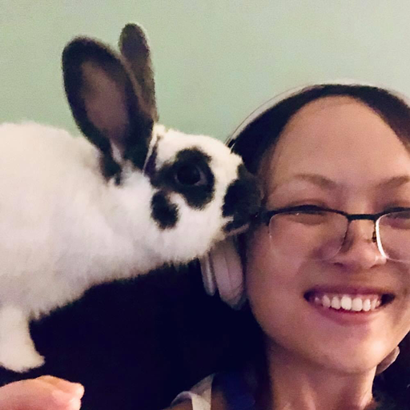
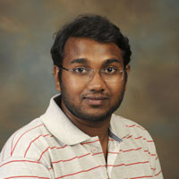

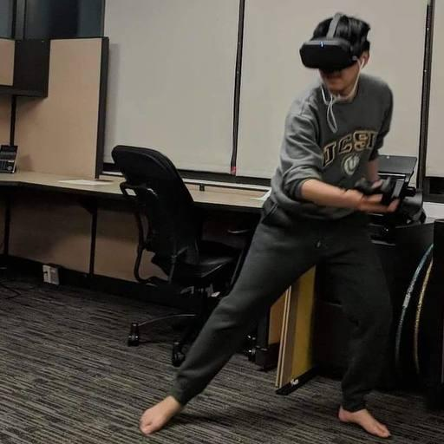
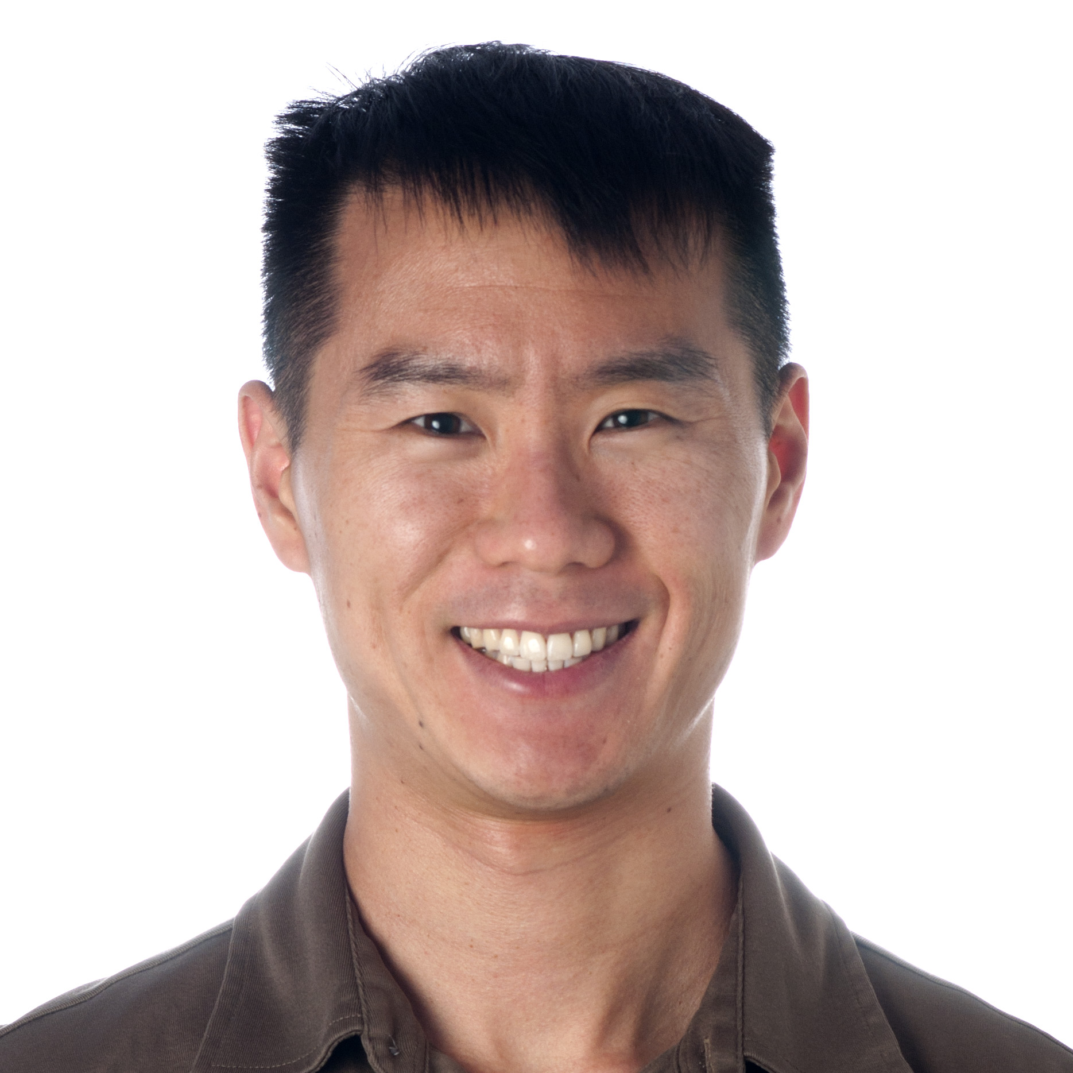
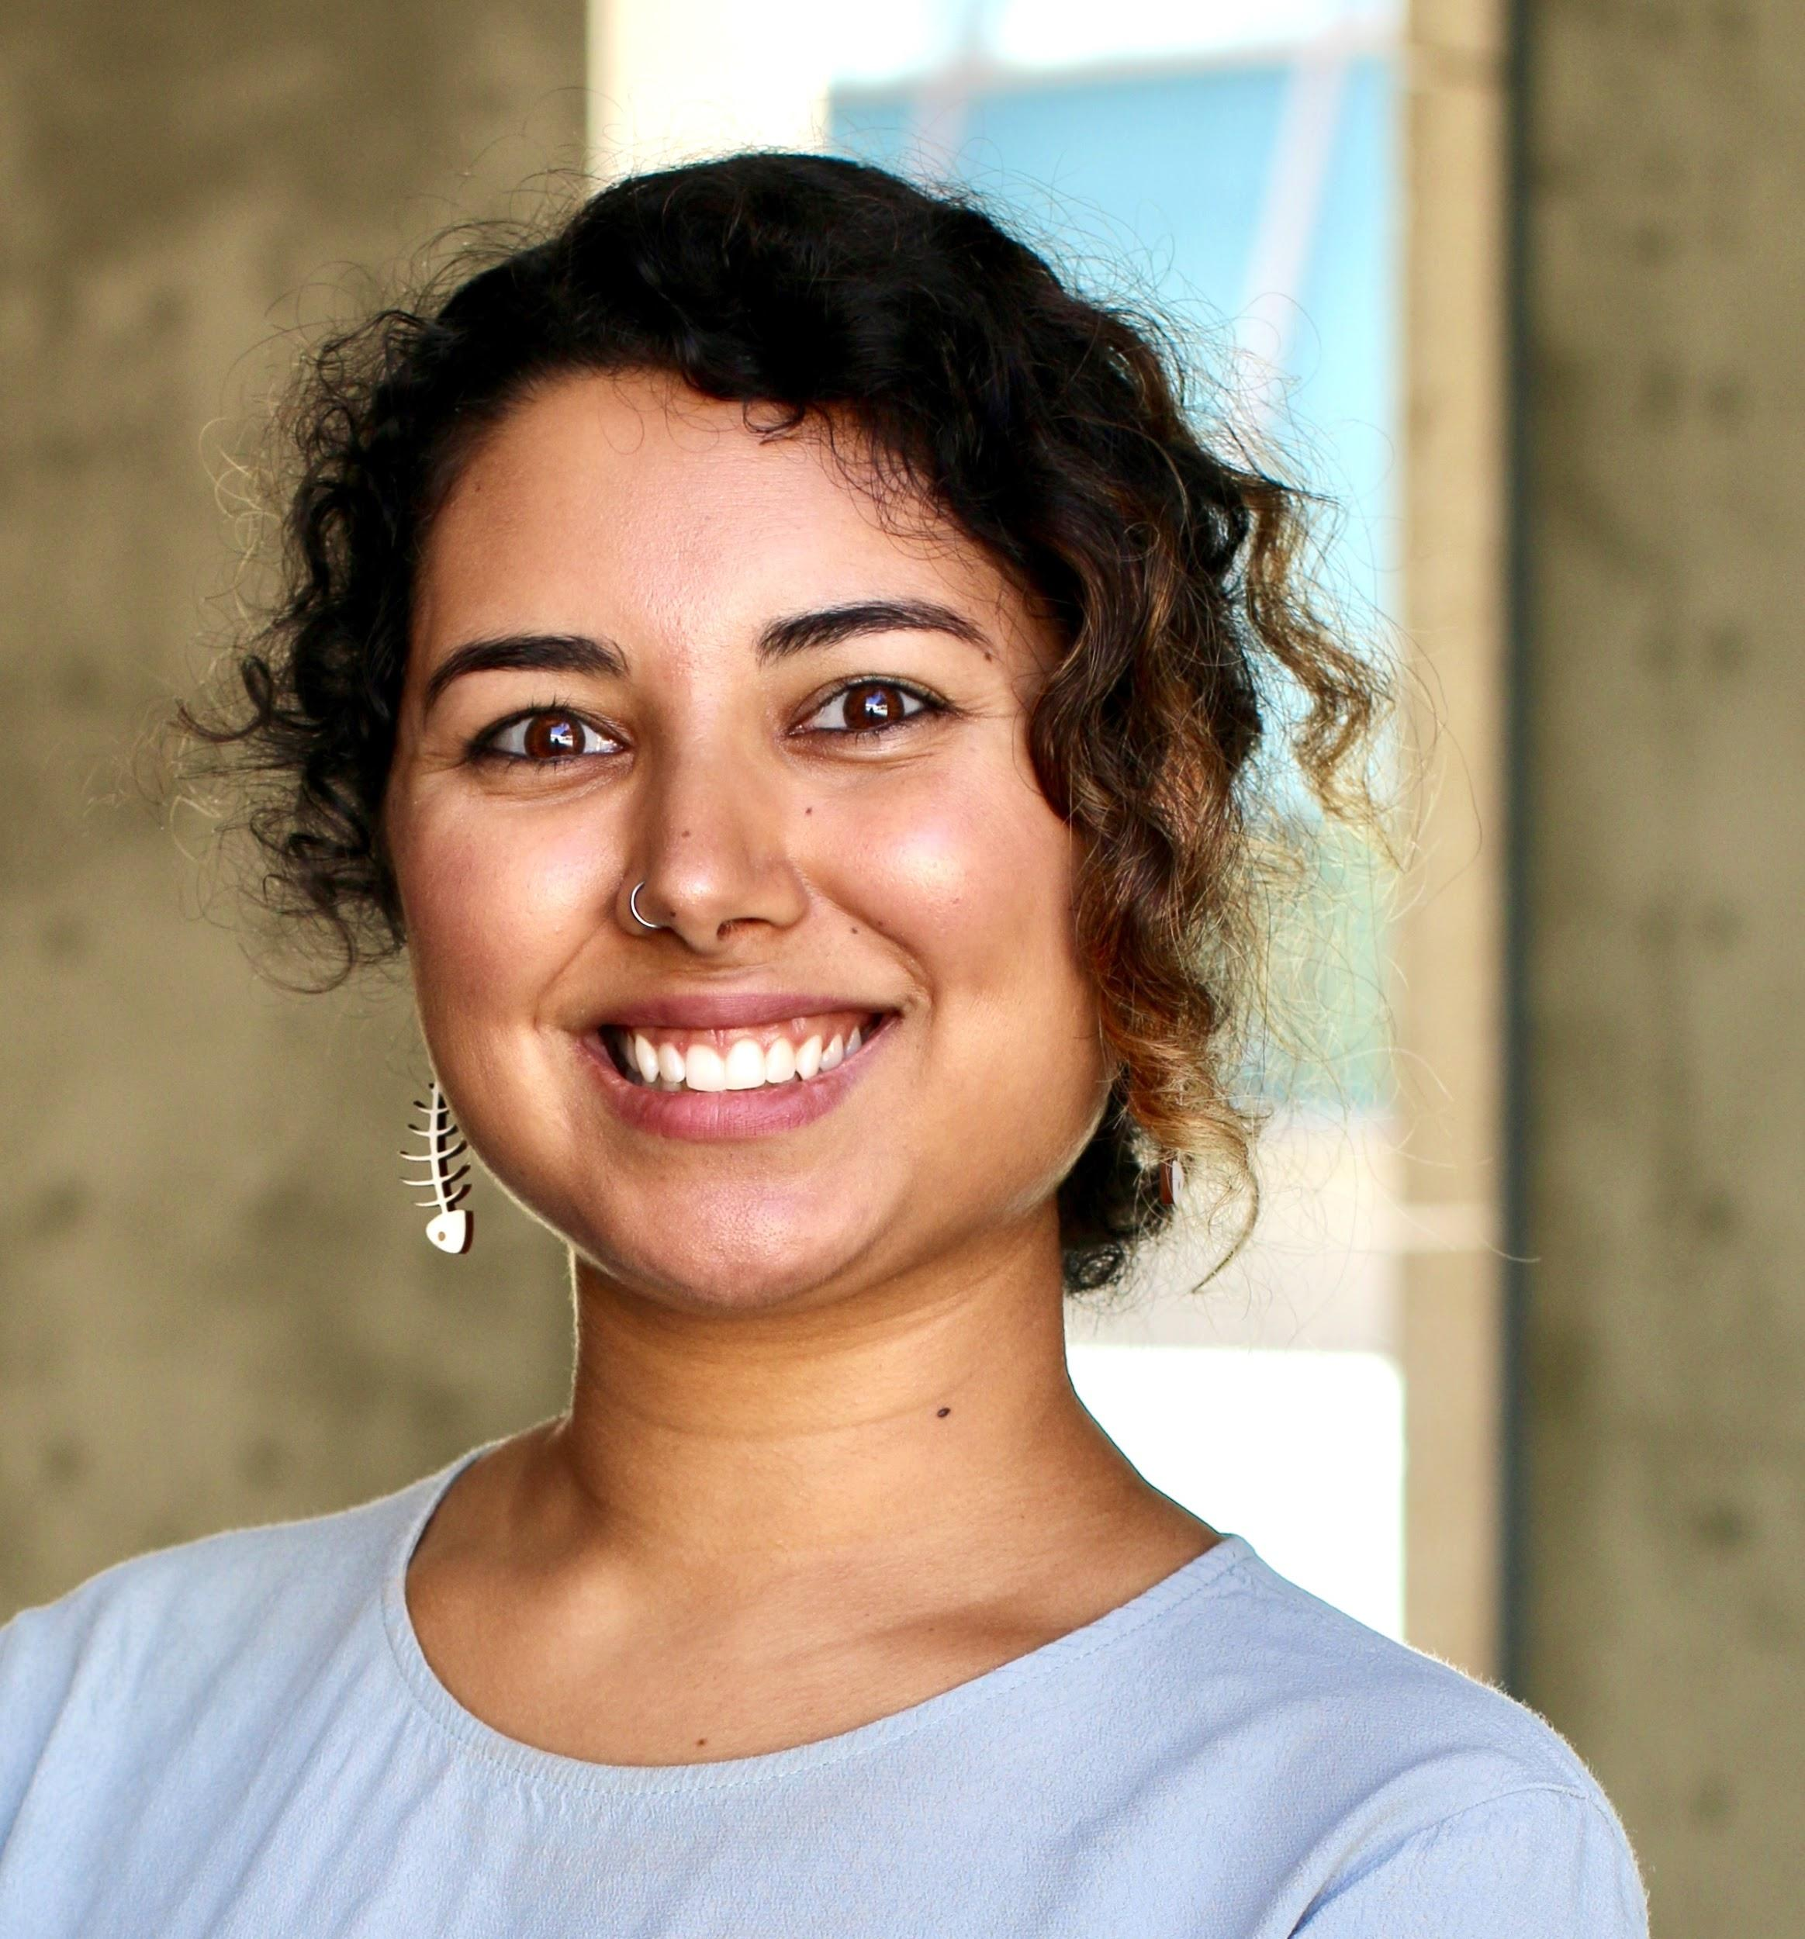
Reach out -- We’re here for you!
Expertise
Mentorship
Professionalism
Communicative
We’re humans, too (as are you!) We’ll be decompressing during non-business hours
Support of you being your healthiest self
Huitian Dao
Karthik Gangavarapu
Shang-Fu
Chen
Andrew Su
Sabah Ul-Hasan

Slide 4
Question 1
string <- TRUE ;what kind of object is ‘string’ ?
character numeric logical
Question 2
To convert a data.frame of different data types to the same types... I can split it into multiple matrices I can utilize the as.factor() function and adjust my code accordingly Both options are valid Neither option is valid
Question 3
What is the R Kernel equivalent for Python %%bash? system( ) bash( ) system{ }
Notes:
Want to know if you encounter unwelcoming behavior outside or inside classroom

Slide 5
Resources
x

Slide 6
What’s an Object?
x
https://data-flair.training/blogs/object-oriented-programming-in-r/

Slide 7
How to ‘Operate’ on an Object?

Slide 8
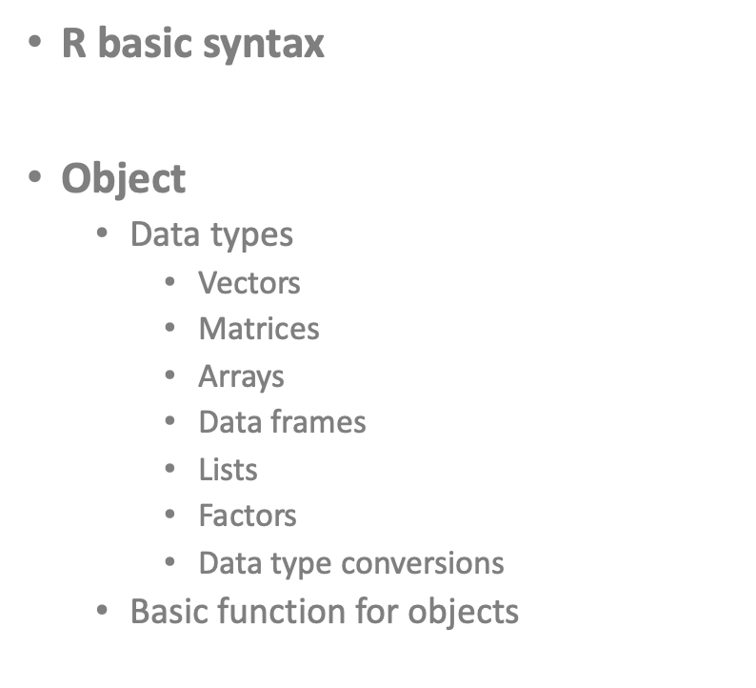
How to ‘Operate’ on an Object?

Slide 9
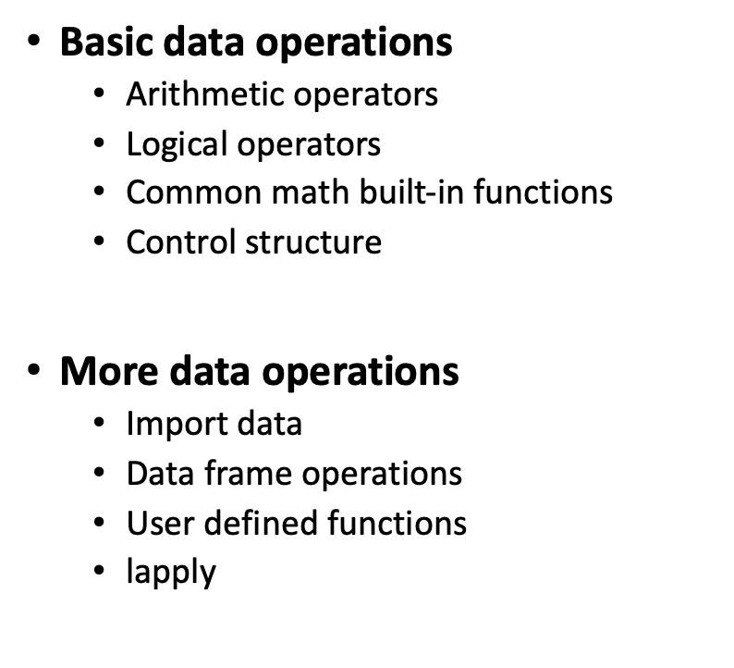
How to ‘Operate’ on an Object?

Slide 10
Statistical Analyses (2+3 demo cnt’d)
Arithmetic operators
+ | addition
- | subtraction
* | multiplication
/ | division
** or ^ | exponentiation
%% | modulus
%/% | integer division

Slide 11
Statistical Analyses (2+3 demo cnt’d)
Logical operators
> >= | Greater Greater or equal
< <= | Less Less or equal
== != | Equal to Not equal to
! | NOT
| | OR
& | AND
isTrue() | If … is true

Slide 12
Statistical Analyses (2+3 demo cnt’d)
abs() | Absolute value
sqrt() | Square root
ceiling() | Ceiling(3.457) is 4
floor() | Floor(3.457) is 3
trunc() | Trunc(5.99) is 5
round() | Round(3.457, digits=2) is 3.48
signif() | Signif(3.475, digits=2) is 3.5
sin() cos() tan() | Trigonometric functions
log() log10() | Natural logarithm or common logarithm
exp() | e^

Slide 13
Something Old (Loops), Something New (Conditionals)

Slide 14
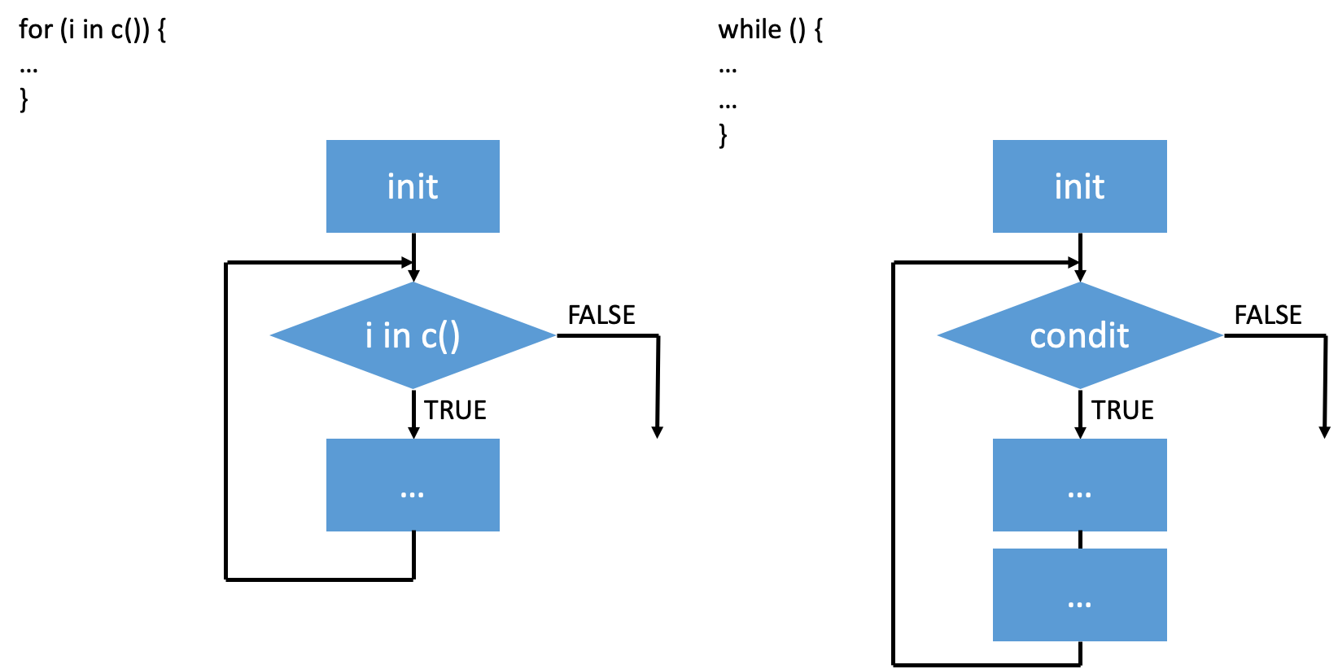
Something Old (Loops), Something New (Conditionals)

Slide 15
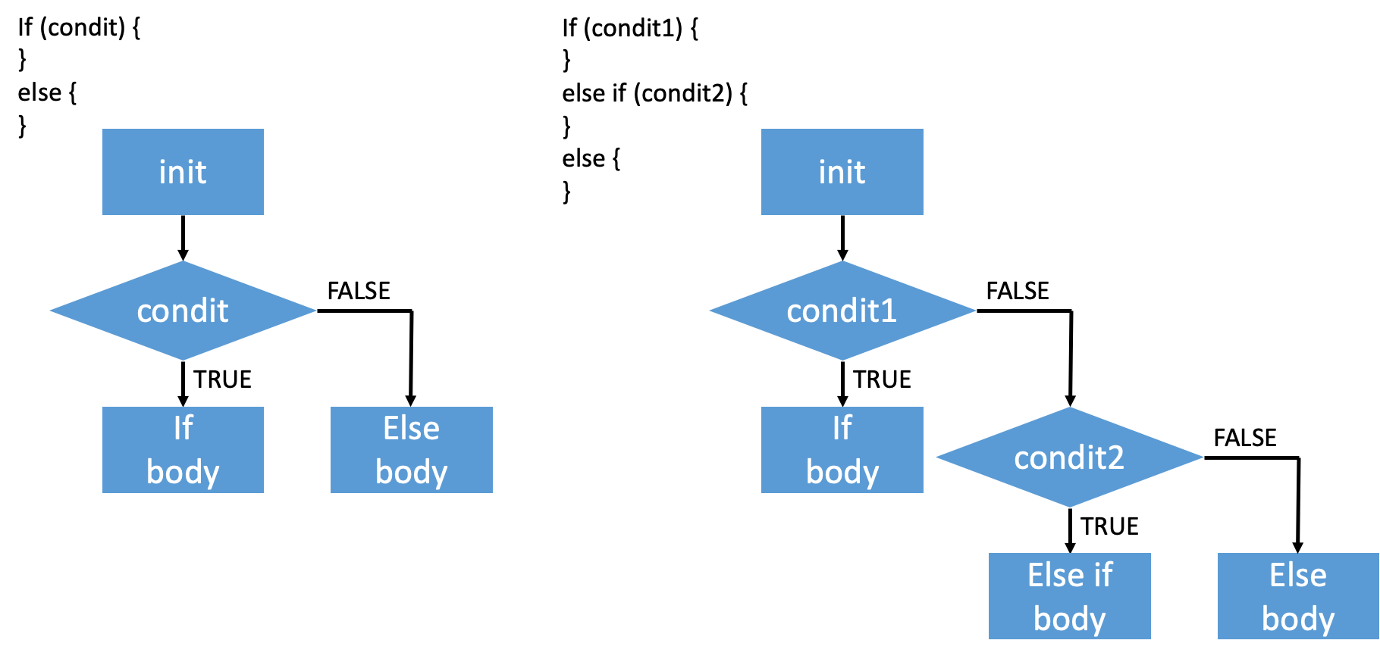
2+3 demo cnt’d
Notes:
Want to know if you encounter unwelcoming behavior outside or inside classroom

Slide 16
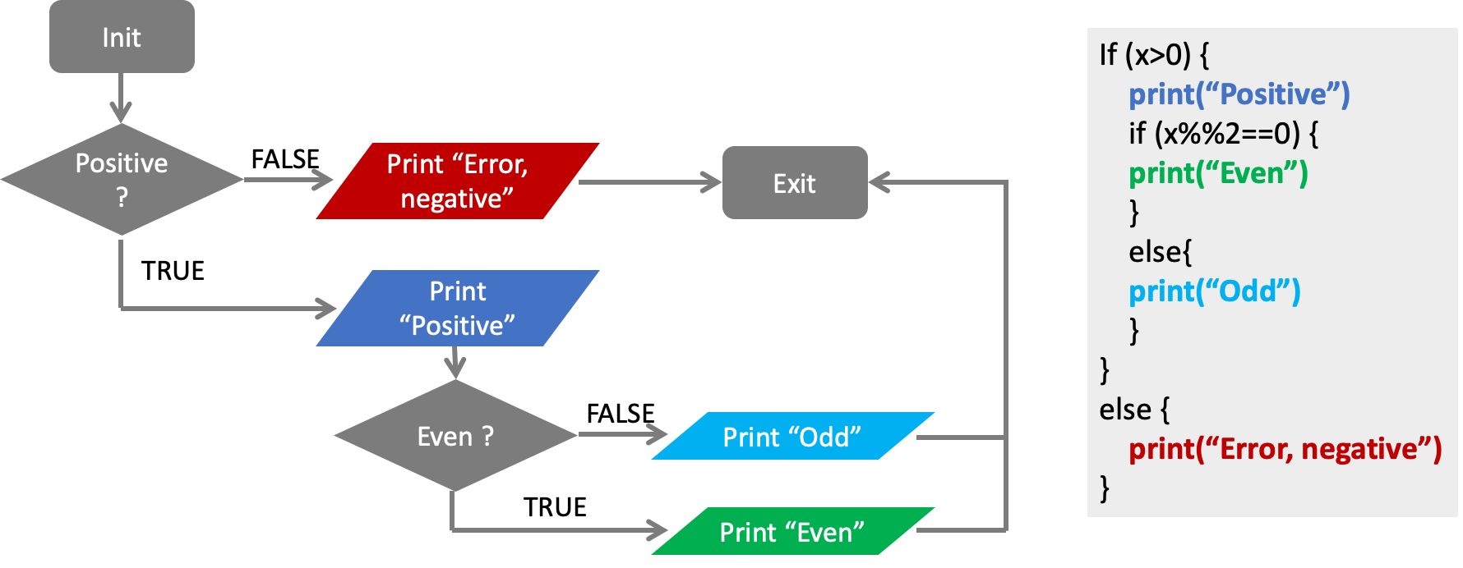
Notes:
Want to know if you encounter unwelcoming behavior outside or inside classroom

Slide 17

Think-Pair-Share
[ ] Open HW 3, complete A3.ba in pairs (or 3s)

Slide 18
A3.bb
Applying R to Biology
Sabah Ul-Hasan
Credit: Huitian Dao

Slide 19
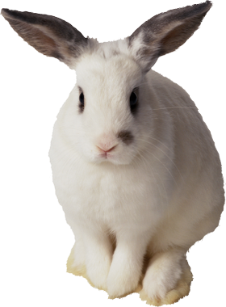
Experimental Design - What goes into it?
Garbage in, garbage out
https://www.statmethods.net/stats/power.html

Slide 20
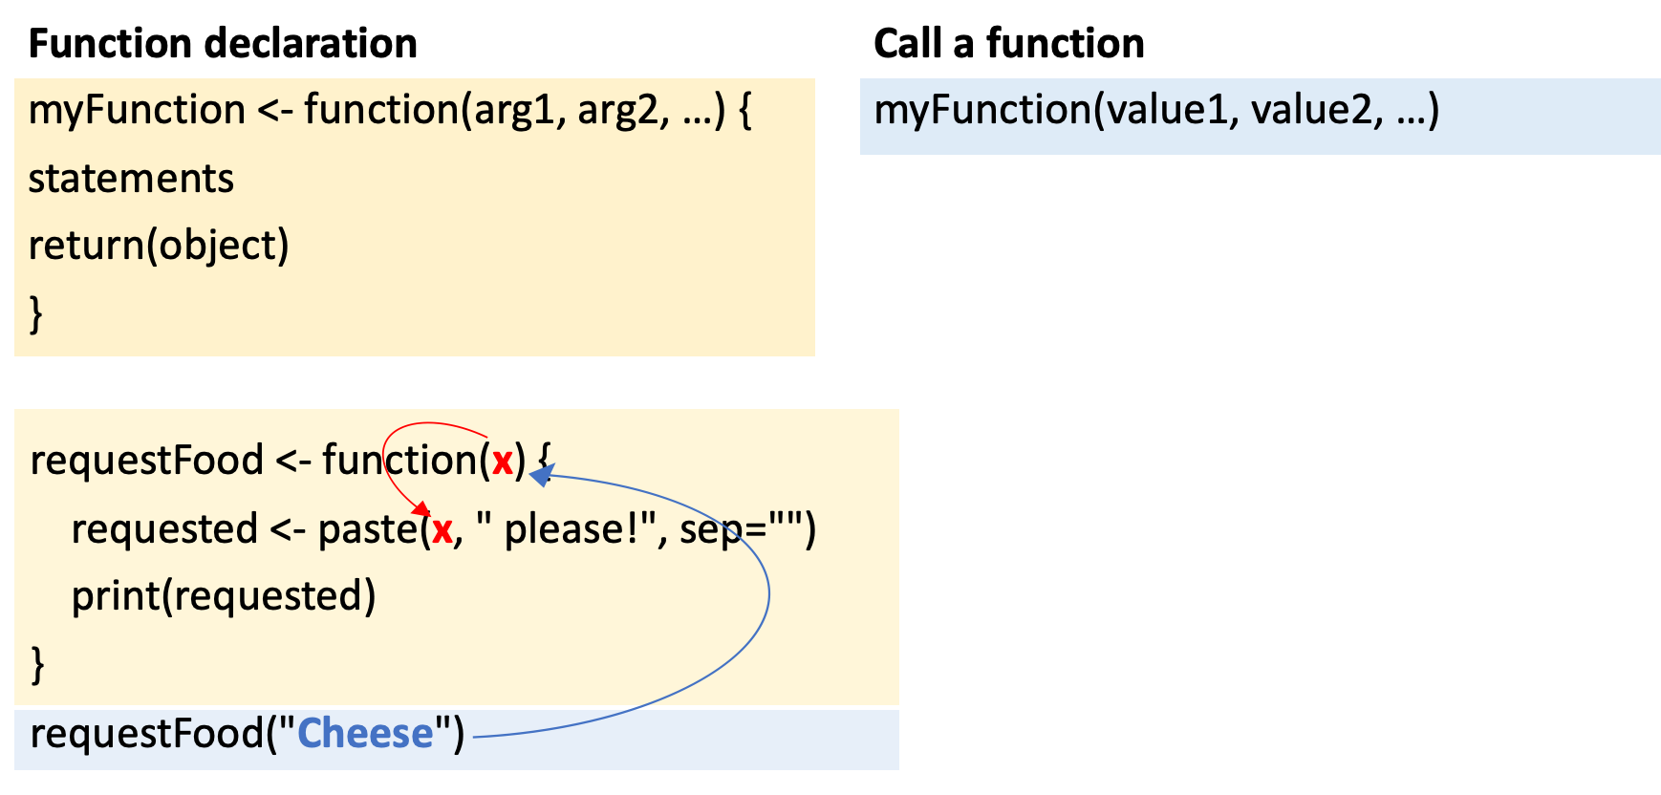
Functions
https://swcarpentry.github.io/r-novice-inflammation/02-func-R/

Slide 21
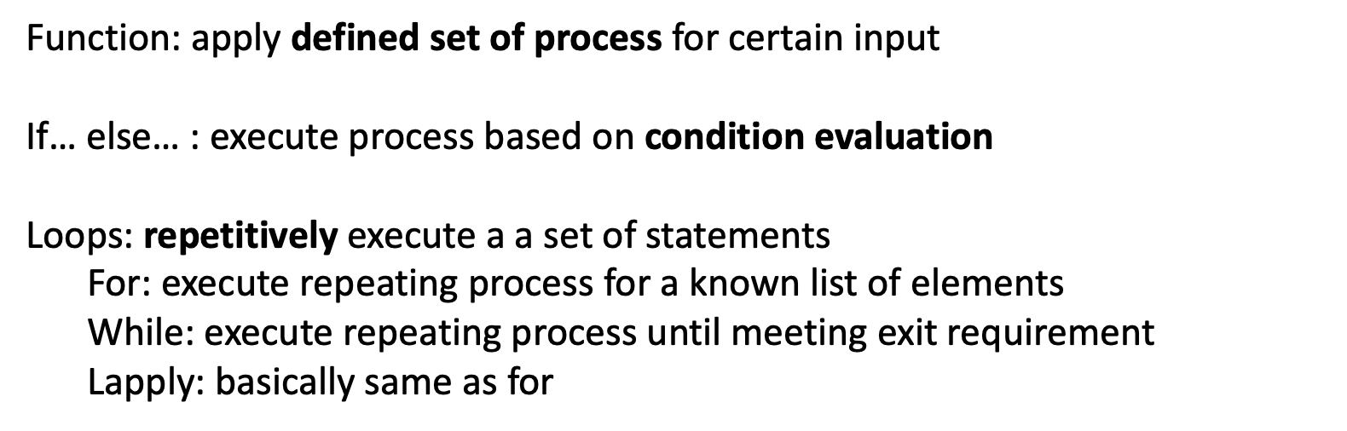
Summary

Slide 22

Individually,
[ ] Work through A3.bb Q9-10

Slide 23
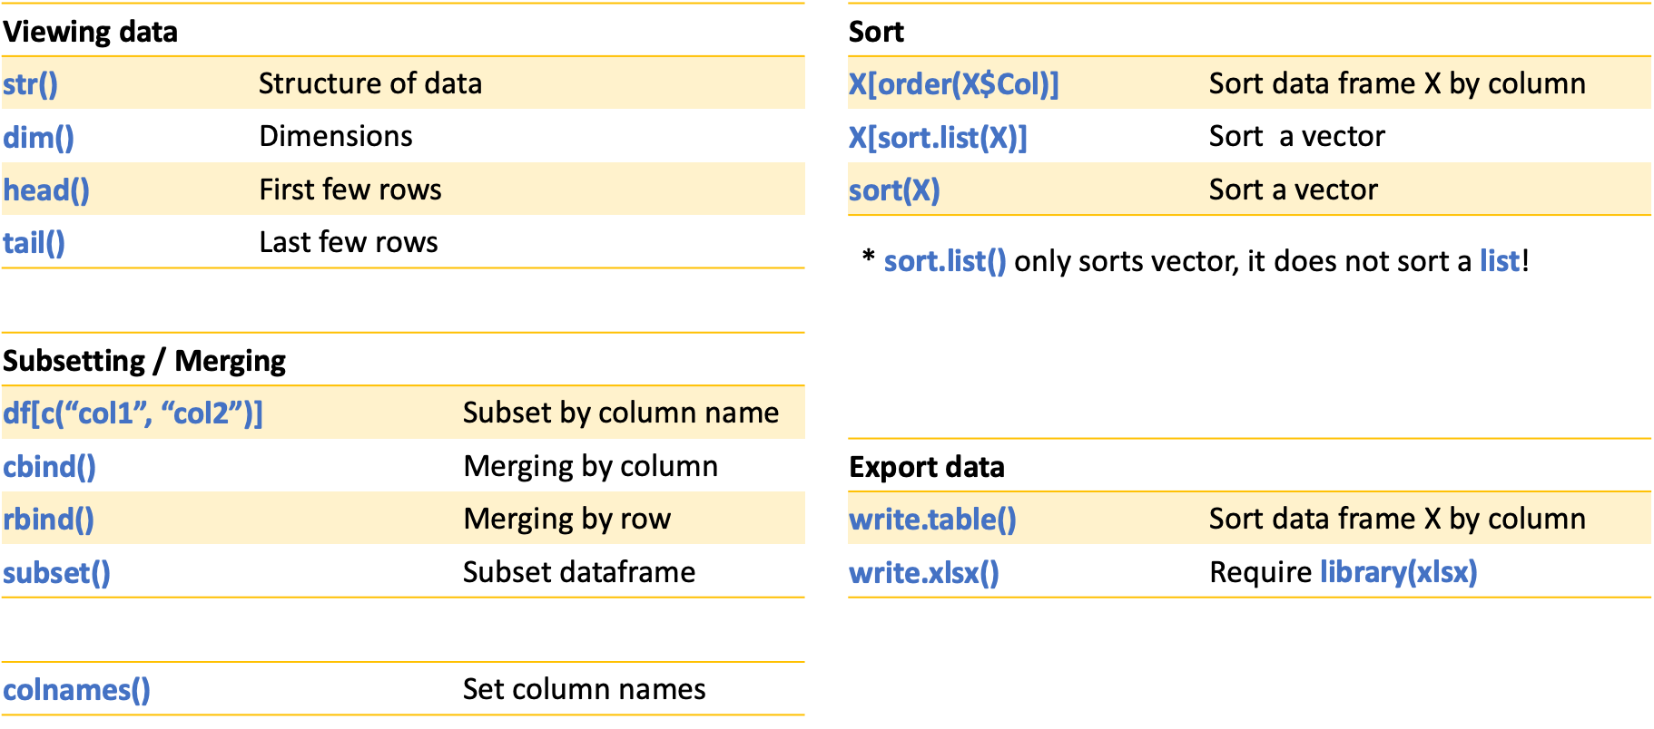
Dataframe operations

Slide 24
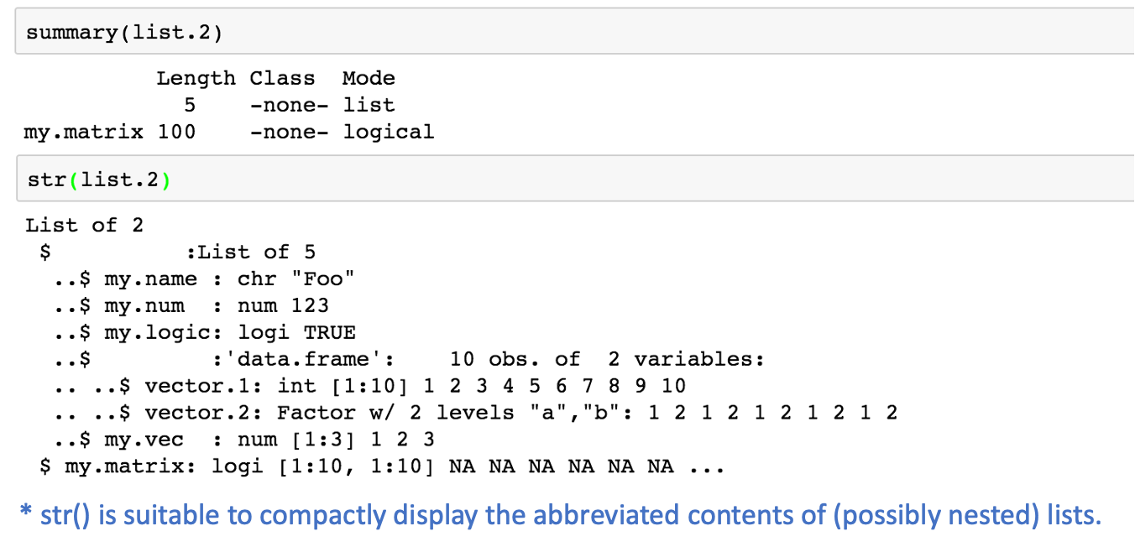
Viewing df with str()

